Slide 1
Programming 4
07.1 Manual Scrolling Tile Map
Semester 2, 2019

Slide 2
Scrolling
The world can be much larger than what is shown on our screens
In a scrolling game, the tile mapping technique is the same
Except the map is bigger than the screen

Slide 3
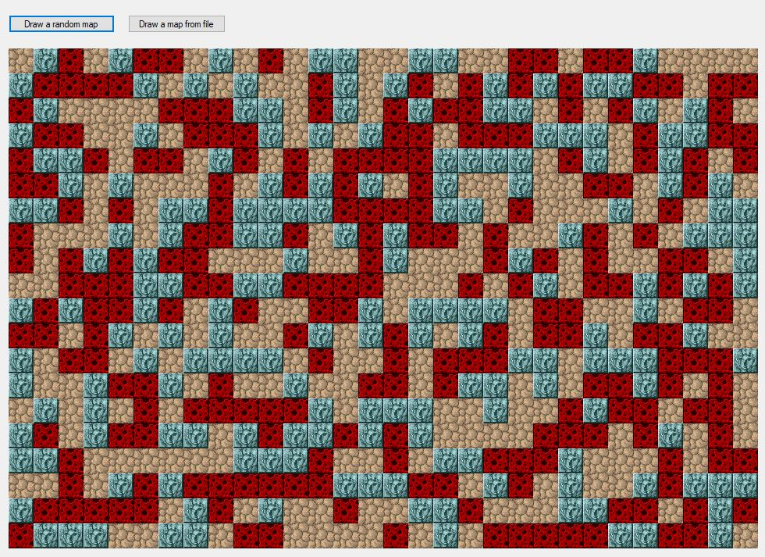
Scrolling

Slide 4
Example world
Super Mario Bros (NES)
SMB uses 16x16 pixel tiles
SMB uses a world that is very wide, but only one
screen high (211 tiles wide and 14 tiles high)

Slide 5
Example viewport
Viewport is 18 tiles wide and 14 tiles high

Slide 6
Coordinate systems
(0,0) in Viewport coordinates
(screen coordinates)
(100, 100) in World
coordinates
(0, 0) in
World
coordinates

Slide 7
Coordinate systems
(0,0) in Viewport coordinates
(screen coordinates)
(300, 200) in World
coordinates
(100, 100) in World
coordinates
(0, 0) in
World
coordinates
(200, 100) in Viewport
coordinates

Slide 8
Coordinate systems
(262, 0) in World
(0, 0) in Viewport
(0, 0) in World
World continues…
(300, 200) in World
(38, 200) in Viewport

Slide 9
Creating a world
Your world needs to be big
Extend your TileMap to be much larger than
your screen dimensions
Viewport
World TileMap

Slide 10
Viewport class
Your Viewport class needs to know:
It’s location in the World
It’s row and column dimensions
The world TileMap to work from
The Graphics canvas to draw to

Slide 11
Viewport class

Slide 12
How the Viewport draws itself
Draw all the world tiles that are in the Viewport’s area
We must be able to:
Start at the upper left location of the Viewport (in the world)
Double for loop over all rows and columns of the Viewport
Get each TileBitmap
Figure out where to draw it on the canvas

Slide 13
1. Iterate over the Viewport

Slide 14
2. What Tile to start on?

Slide 15
2. What Tile to start on?

Slide 16
3. Getting a TileBitmap => data chain

Slide 17
New TileMap method needed

Slide 18
The double for loop

Slide 19
Where to draw on the screen

Slide 20
Moving the Viewport

